Slide 1
Ethereum Decentralized Voting App
BY
Samson-121823901004
Manoj -121823901005

Slide 2
Why a Decentralized Voting app?
Solves-the main problems plaguing current democratic elections.
transparency,
security,
accessibility,
audibility
immutability
every vote can irrefutably be traced back
User can vote from anywhere from his account
Allows you to perform the actions without a trusted third party.
No single user controls and can be inspected by anyone

Slide 3
Application
Core components
Smart Contracts
EVM
Web3.JS
Other tools
NPM-Node JS
Truffle- (Pet shop)
Ganache Client
Meta Mask
NPM: https://nodejs.org
Truffle: https://github.com/trufflesuite/truffle
Ganache: http://truffleframework.com/ganache/
Metamask: https://metamask.io/

Slide 4
Steps
Step 1. Install the above packages
Step 2.Write the Smart contract
Step 3. Start Ganache
Step 4. Compile & Deploy Election Smart Contract
$ truffle migrate –reset
Step 5. Configure Metamask
Step 6. Run the Front End Application
$ npm run dev
Step 7. Visit http://localhost:3000

Slide 5
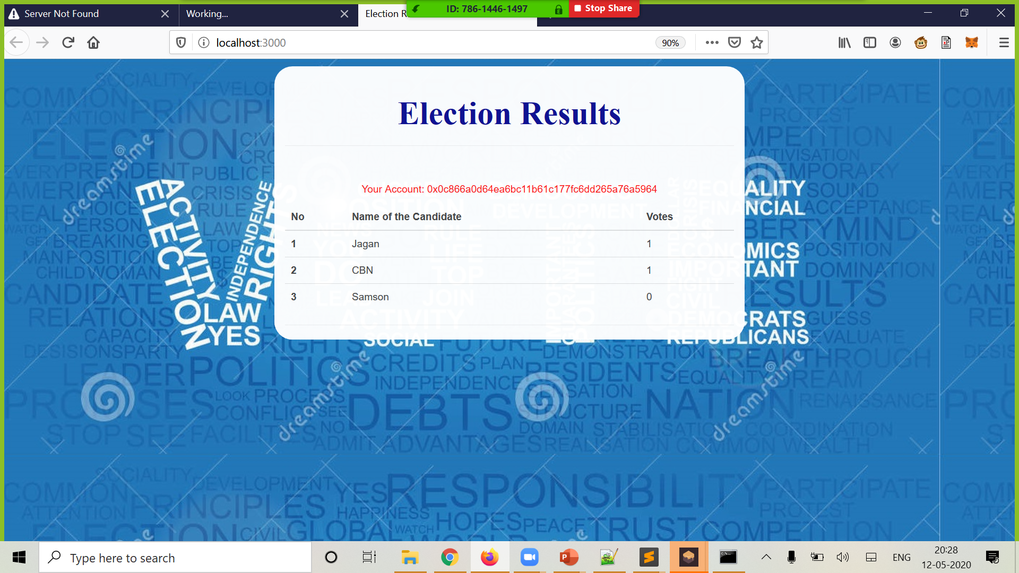
Execution

Slide 6
Queries?

Slide 7
THANK YOU

